Slide 1
Unit 10 The Legal Profession
English for Lawyers II
Snježana Husinec, PhD., shusinec@pravo.hr

Slide 2
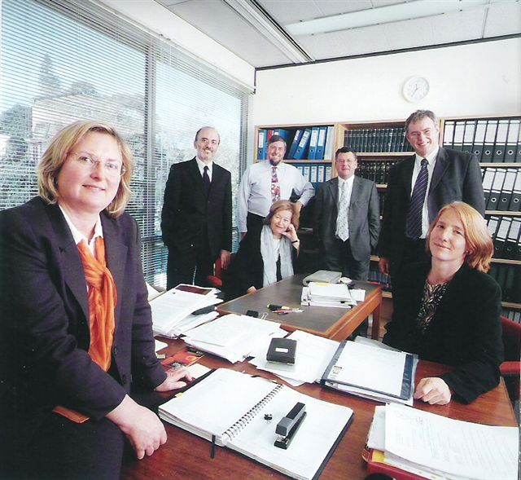
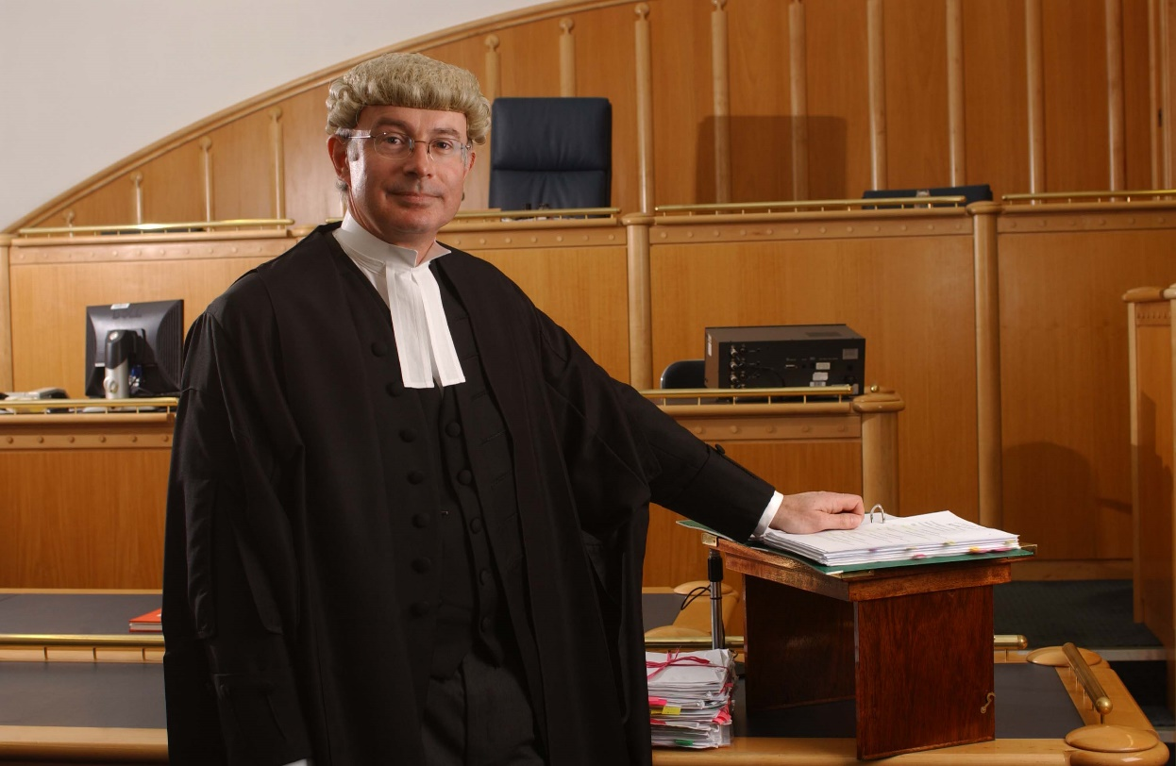
Legal Professionals What different types of legal professionals do you know of? Who are the ones in the pictures?
SOLICITOR
BARRISTER

Slide 3
A Career in Law in England and Wales
Do ex. 1 on p. 85.
Read the text quickly and decide which type of lawyer is described in the first and which in the second part of the text. Supply subtitles.

Slide 4
Barristers and solicitors
Join in pairs. Person A reads the text about solicitors, student B about barristers. Extract the key facts about the work of ¨your¨ type of legal professional and complete the table.
Join in pairs and report to your partner about ¨your¨ type of legal professional.
 | SOLICITORS | BARRISTERS
Types of legal services provided
Daily activities
Right of audience
Type / place of employment

Slide 5
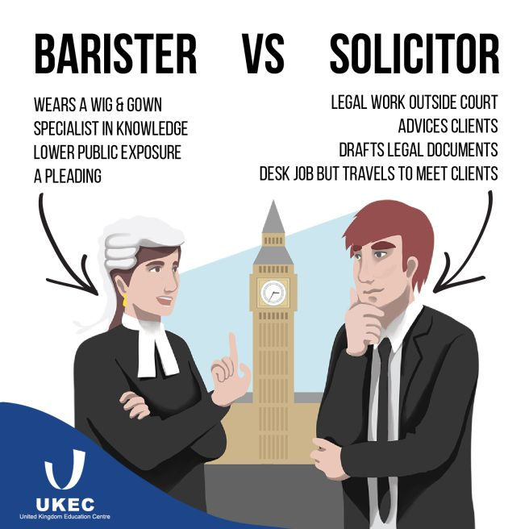
Do ex. IV and discuss the similarities and differences between barristers and solicitors.

Slide 6
PUBLIC ACCESS rules (2004)
a scheme which enables members of the public and businesses to instruct a barrister directly to provide legal advice and representat in court (introduced in July 2004)
allows lay clients to contract with (instruct) a barrister directly
GOAL
- introduced as a part of the wider scheme to make it easier and cheaper for the general public to access legal advice
all areas of the law come within Public Access, including criminal, family and immigragiton work; not available if the work is funded out of legal aid
BENEFITS FOR LAY CLIENTS
lowers the costs – only one legal adviser is paid for – more able to afford the legal advice they need
direct access to specialist legal advisors and advocates
flat fee or “no win, no fee” agreements are available
a solicitor is instructed only if needed and on the recommedation of a barrister

Slide 7
Two types of BARRISTERS
Junior Counsel
all practising barristers until they become Queen’s Counsel
Queen’s Counsel
the honour given to a barrister (or a solicitor with advocacy qualification) who has practiced law for at least 10 years (on the recommendation of the Lord Chancellor) to earn the right to wear silk gown ('takes silk' as it is called) and take precedence over other Barristers in the court
10% of the Bar
take on more complicated and high-profile cases
senior judges chosen from the ranks of QCs

Slide 8
Education and qualifications of barristers and solicitors
Study the table with information about their education.
Read the texts in which Catherine Bradley and Peter Smith talking about their education and training as a barrister and a solicitor.
Complete the texts with the information from the table.
Complete the table in ex. V.

Slide 9
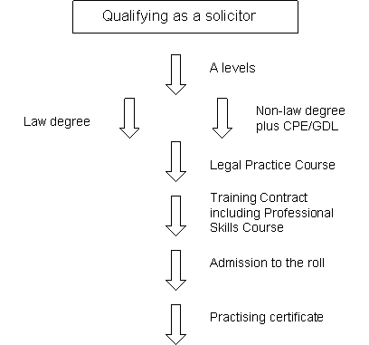
Training and Qualification SOLICITOR
3 STAGES
1) gaining an undergraduate degree in law (Bachelor of Laws - LLB) or a degree in a non-law subject and complete a one year conversion course in law – the graduate Diploma in Law (GDL)
2)Attending the Legal Practice Course (LPC) and passing the exam at the Law Society
3) Traineeship – a two year traininig contract with a legal firm
Admission as a fully qualified solicitor with a Certificate of practice

Slide 10
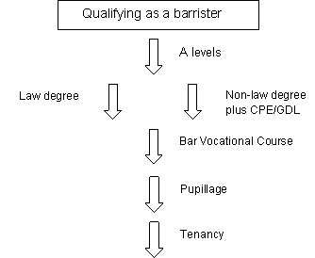
Training and Qualification BARRISTER
3 STAGES
1) gaining an undergraduate degree in law (Bachelor of Laws - LLB) or a degree in a non-law subject and complete a one year conversion course in law – the graduate Diploma in Law (GDL)
2) –joininig one of the Inns of Court;
Passing a one-year Bar Professional Traininig Course (BPTC) + Call to the Bar;
3) Pupillage – a one-year work-based traininig at a set of barristers’ chambers;
Full qualificaion certificate – full RIGHT OF AUDIENCE in any court of law in England and Wales

Slide 11
CV of a newly qualified solicitor
When applying for a job what documents do you need to enclose?
What is a cover letter?
What is a CV?
Read the CV of a newly qualified lawyer Mark Bradley and answer the questions in ex. III.

Slide 12
Vocabulary practice
Combine the nouns in the box with the verbs below to make combinations to describe the work lawyers do. Some of the verbs go with more than one noun.
cases clients contracts corporations decisions defendants disputes law legislation
1 advise
2 draft
3 practise
4 represent
5 research
7 argue
8 litigate
9 plead

Slide 13
Vocabulary practice - Key
Combine the nouns in the box with the verbs below to make combinations to
describe the work lawyers do. Some of the verbs go with more than one noun.
cases clients contracts corporations decisions defendants disputes law legislation
1 advise – clients, corporations, defendants
2 draft – contracts, decisions, law, legislation
3 practise – law
4 represent – clients, corporations, defendants
5 research – cases, decisions, law, legislation
7 argue - cases
8 litigate – cases, disputes
9 plead - cases

