Slide 1
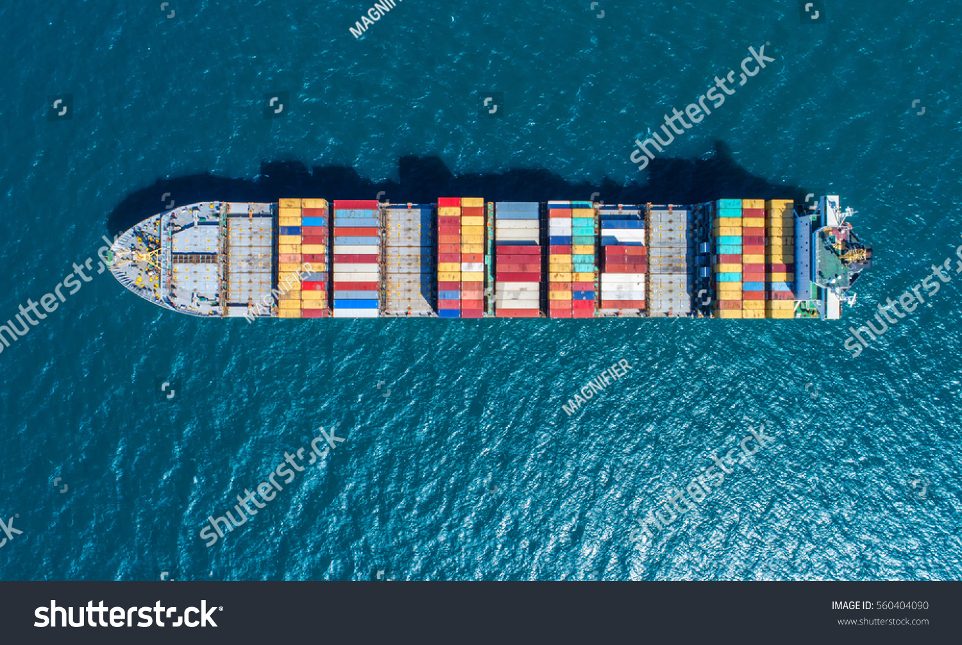
Notes:
XYX:XYX tons of good transported by sea on the territory of the MS
PRESTIGE, November 2002, Erika, December 1999
Illegal discharge of waste
MARPOL-Protocol was signed in the 70s to completely eliminate pollution. Problem:
Sanctions for ship-source pollution differed significantly within the MS of the EC

Slide 2
How it all began…
TO HARMONIZE MS LEGISLATION ON PROTECTION OF THE WATERS THE COMMISSION PROPOSED DIRECTIVE 2005/35
THE COUNCIL THEN CONCRETIZED THE GOALS OF THE DIRECTIVE WITH A FRAMEWORK DECISION 2005/667
Contents of FD 2005/667:
MS OBLIGED TO ESTABLISH CRIMINAL SANCTIONS IN THEIR NATIONAL LAW
TYPE AND HEIGHT OF SANCTIONS

Slide 3
The fight -or- CASE C-440/05
The commission
The council
→ FD LACKS A LEGAL BASE
SHIP-SOURCE POLLUTION = COMMON TRANSPORT POLICY = 1ST COLUMN = RIGHT OF THE EC, not MS
→ THE LEGAL BASE IS ART. 80 II TEC
“The Council can […] decide whether, to what extent and by what procedure […] provisions may be laid down for sea […] transport.”
THE COUNCIL HAS A RIGHT TO CHOOSE (“can […] decide”, Art. 80 II TEC) AND DECIDED AGAINST IT
= NO EC, but MS COMPETENCE FOR ESTABLISHING SANCTIONS

Slide 4
The decision – part 1
It depends on the primary aspect of the FD: not criminal sanctions, but common transport policy, including environmental protection
= basic task of the EC, Art. 70 TEC and Art 80 I TEC
Art. 80 II TEU: “The Council can […] decide whether, to what extent and by what procedure […] provisions may be laid down for sea […] transport.”
→ Legal base: Art. 80 II TEC → FD 2005/667 no legal base!

Slide 5
The decision - part 2 – pro commission
CRIMINAL LAW LAYS OUTSIDE THE EC COMPETENCE - HOWEVER –
THE EC LEGISLATOR HAS THE RIGHT TO OBLIGE MS TO INTRODUCE SANCTIONS
IF:
Sanctions are effective, proportionate and dissuasive
Measure is essential
Sanctions combat serious damage
For environmental protection
To ensure full effectiveness of legal regulations

Slide 6
Decision – part 3
THE LEGISLATOR OF THE EC CANNOT DECIDE OVER TYPE AND HEIGHT OF SANCTIONS

