Slide 1
English for Tax Administration Study 3
Lecturer: Miljen Matijašević
e-mail: miljen.matijasevic@gmail.com
G10, room 6, Wed 15:30-16:30
Session 3, 21 Oct 2014

Slide 2
Today’s session
Revision of the previous session
Introduction to the European Union
History of the EU
EU language policy
EU legislation

Slide 3
REVISION OF THE PREVIOUS SESSION

Slide 4
translate the following terms into english
nasljednik
oporučitelj
umrijeti bez oporuke
izvršitelj oporuke
sudska ovjera oporuke
oporučni dar

Slide 5
translate the following terms into english
nasljednik – beneficiary, legatee
oporučitelj – testator
umrijeti bez oporuke – to die intestate
izvršitelj oporuke – executor of the will
sudska ovjera oporuke – probate
oporučni dar – devise, bequest, legacy

Slide 6
TRANSLATE THE FOLLOWING SENTENCES
This codicil revokes all my previous wills.
To my daughter, Elise, I leave a pecuniary bequest of 1,200 pounds.
I appoint my wife, Dana Russell, and my solicitor, Robert Croydon, to be the executors of this will.
I bequeath all the residue of my real and personal estate to my spouse at the time of my death.

Slide 7
TRANSLATE THE FOLLOWING SENTENCES (sample answers)
Ovim dodatkom oporuci opozivaju se sve moje prethodno napisane oporuke.
Svojoj kćeri Elise ostavljam novčanu ostavštinu u iznosu od 1200 funti.
Svoju suprugu Danu Russell i svog odvjetnika Roberta Croydona imenujem izvršiteljima ove oporuke.
Ukupni ostatak svojih nekretnina i osobne imovine ostavljam supruzi koju budem imao u vrijeme svoje smrti.

Slide 8
The European Union

Slide 9
European Integration
What do you know about the following:
the European Union
the European Community
the European Economic Community
the Council of Europe

Slide 10
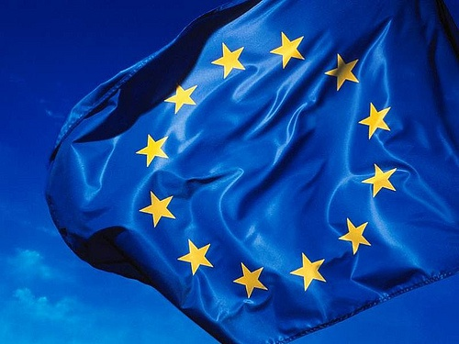
European Integration
How many states are members of:
the European Union
28
the Council of Europe
47

Slide 11
History of the EU

Slide 12
European Integration - history
idea of a united Europe born after World War II
the continent was devastated by the war
strong desire to prevent new conflicts
various initiatives brought together into the International Committee of the Movements for European Unity
the Hague Congress (7 May 1948), remembered as "The Congress of Europe"

Slide 13
European Integration - history
two models proposed:
a federative union of states (like the USA), supported by Belgium and France,
a form of intergovernmental co-operation, preferred by the UK
result: the Council of Europe (model 2)

Slide 14
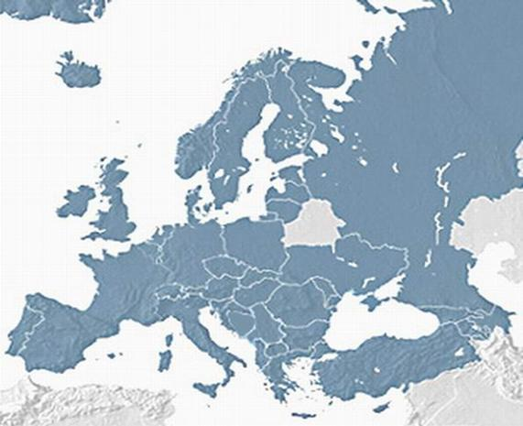
The Council of Europe

Slide 15
European Integration - history
references to the economic and political union declared at the Hague Congress were dropped
this gave rise to the development of initiatives which led to the formation of the European Communities

Slide 16
European Integration
France dissatisfied with the scope of the Council of Europe
fear of Germany rising to military power again
Schuman (French foreign minister) initiated the formation of a union of the French and German coal and steel industries

Slide 17
European Communities
European Coal and Steel Community
Treaty of Paris, 1951
France, Germany, Italy, Belgium, the Netherlands, Luxemburg
European Economic Community (single market)
European Atomic Energy Community (Euratom)
Treaty of Rome, 1957

Slide 18
European Communities
Single European Act, 1986
formally establishes the economic and customs union, the single market and the four freedoms
free movement of:
goods
services
persons
capital
deadline for implementation: 1992

Slide 19
European Union
Treaty establishing the European Union (a.k.a. the Maastricht Treaty, 1992)
aims: a border-free area
common foreign and security policy
judicial and police co-operation
economic and monetary union
creation of the EURO
the euro put into circulation in 2002

Slide 20
European Union
The three pillars of the EU:
European Community (EEC+ECSC+Euratom)
Common Foreign and Security Policy
Justice and Home Affairs
pillar 1 – the EC has more powers to legislate directly
pillars 2&3 – intergovernmental co-operation

Slide 21
1. European Community
single market, common agricultural policy
economic and monetary union
EU citizenship, the Schengen Area
education and culture
transeuropean traffic networks,
health care,
science,
environmental protection
social policy

Slide 22
2. Common Foreign and Security Policy
human rights
democracy
common defense policy
peace keeping

Slide 23
3. Justice and Home Affairs
drug and arms trafficking,
terrorism,
human trafficking,
organised crime,
bribe and corruption

Slide 24
European Union
Treaty of Amsterdam (1997)
implements the Schengen area
institutional reforms
Treaty of Nice (2001)
enables further enlargement
institutional reforms

Slide 25
European Union
Treaty of Lisbon (2007)
unites the three pillars into one: the European Union
President of the EU
stronger foreign policy role
enables further enlargement
extends co-decision

Slide 26
Enlargement History
1951 – France, Germany, Italy, Belgium, the Netherlands, Luxemburg (6)
1973 – the UK, Ireland, Denmark (9)
1981 – Greece (10)
1986 – Portugal, Spain (12)
1995 – Sweden, Finland, Austria (15)
2004 – the Czech Republic, Slovakia, Poland, Estonia, Latvia, Lithuania, Hungary, Slovenia, Malta, Cyprus (25)
2007 – Bulgaria, Romania (27)
2013 – Croatia (28)

Slide 27
Enlargement of the EU

Slide 28
Language Policy
Council Regulation (EEC) No. 1 of 6.10.1958. determining the languages to be used by the European Economic Community
lays down the official languages (French, Italian, Dutch and German) and the language policy of EEC member states (later applied to EU)
MULTILINGUALISM – a key feature of the EU

Slide 29
Language Policy
every EU citizen has the right to use their own language
all laws translated into and available in all EU languages
currently 24 official languages of the EU
working languages – determined by institutions for internal use

Slide 30
EU Legislation

Slide 31
Sources of EU law
EU legislation:
primary legislation
secondary legislation
Court of the EU (ECJ) case law

Slide 32
Primary EU Legislation
founding Treaties and all Treaties amending them
Treaties concerning accession of new Member States

Slide 33
Secondary EU Legislation
legal acts issued by EU institutions
REGULATIONS (uredbe)
DIRECTIVES (direktive)
DECISIONS (odluke)
also:
RECOMMENDATIONS (preporuke)
OPINIONS (mišljenja)

Slide 34
Secondary EU Legislation
REGULATIONS – binding and directly applicable in all Member States, general application
DIRECTIVES – binding, only outline the goals to be achieved and direct how Member States should legislate in certain issues
DECISIONS – binding on the addressee(s) – an individual, group, company, Member State, etc.
RECOMMENDATIONS and OPINIONS – not binding

Slide 35
Vocabulary practice

Slide 36
Translate into Croatian
Member State
enlargement
founding treaty
accession treaty
language policy
official language
working language

Slide 37
Answers
Member State – država članica
enlargement – proširenje
founding treaty – osnivački ugovor
accession treaty – ugovor o pristupanju
language policy – jezična politika
official language – službeni jezik
working language – radni jezik

Slide 38
Thank you for your attention!

