Slide 1
Legal english
A short history

Slide 2
Preview
Historical development of English
Language contacts in the history of English
The spread of English
Development of legal English

Slide 3
A short history of england
https://www.youtube.com/watch?v=VcnSsEVsrf0

Slide 4
Roman britain (43-410)

Slide 5
Roman rule (43-410)
55-54 BC Julius Caesar invaded what is now England as part of the Gallic Wars, and was defeated. He wrote in De Bello Gallico that there were many tribes there, very similar to other Celtic tribes in Europe.
43 AD, Claudius successfully invaded England, which became a Roman province, Britania
43-410 Roman Britain
4th c. many Britons left to cross the English Channel from Wales, Cornwall and southern Britain, and settled the western part of Gaul, where they started a new nation: Brittany. The Britons gave their new country its name and the Breton language, a sister language to Welsh and Cornish.

Slide 6
HISTORY OF THE ENGLISH LANGUAGE
OLD ENGLISH (c. 450- c. 1100)
MIDDLE ENGLISH (c. 1100- c.1450)
MODERN ENGLISH (c. 1450 - )

Slide 7
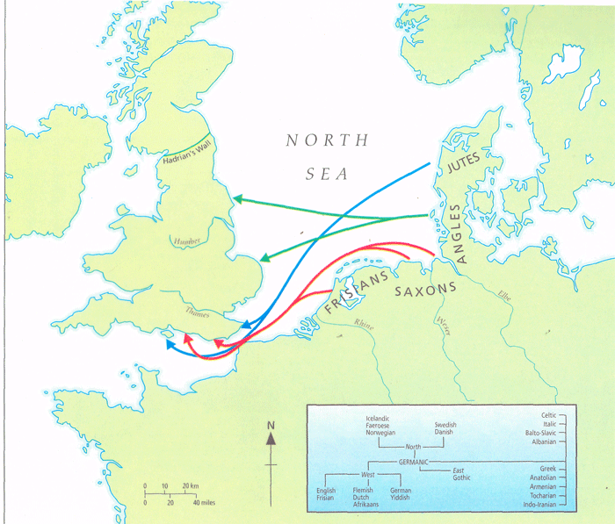
Migrations of Angles, Saxons and Jutes

Slide 8
Anglo-saxon england

Slide 9
Anglo-Saxon England
No continuous tradition of Roman law
Germanic custom + Christian influence
Little literacy, few officials, no central administration, no courts
Early Anglo-Saxon law – primitive and harsh (private vengeance, blood feuds)
Gradually, rulers of the four kingdoms (Kent, Wessex, Mercia, Northumbria) started to intervene against lawlessness and to compose laws, known as dooms, created from existing customs and written in English
„the record of legislation in England is one of the oldest in Europe”

Slide 10
Anglo-Saxon England
The early kings relied on great landowners to whom they granted wide powers of peace-keeping: „There cannot have been much need of courts…to stand between the wrong-doing and retribution: the peace keeper compelled the payment of the set compensation or cut down the outlaw and the thief caught in the act”
Christianity expanded rapidly after 597 (e.g. Aethelbert, king of Kent, familiar with religious practices since his wife, Bertha, a Frankish princess was permitted to hold services in a church at Canterbury with a bishop she brought over to England)

Slide 11
Anglo-saxon england
Courts – local popular assemblies that met every 4 weeks for the administration of customary law
Most common crimes: homicide, wounding,cattle theft
When an offender was caught, there would be no trial but an immediate finr or, if he was poor, immediate death; if he escaped, he would be outlawed, which sanctioned his being lawfully killed
Courts – no trial on questions of fact; verdict from the Almighty: oath helpers or trials by ordeal: used to determine guilt or innocence

Slide 12
Viking invasions in Europe (late 8th c.- mid-11th c.)

Slide 13
SCANDINAVIAN PLACE NAMES

Slide 14
LATER OLD ENGLISH (c. 850 - c.1100) Language Contacts
OLD NORSE
Lexical words
Nouns: birth, bull, dirt, egg, fellow, husband, leg, sister, skin, sky, skirt, window
Adjectives: ill, low, odd, rotten, sly, weak
Verbs: call, crawl, die, get, give, lift, raise, scream, take,
Function words
Pronouns: they (their, them)
Conjunctions: though
Determiners: some, any
Auxiliaries: are
Names
Family names: -son: Johnson, Stevenson
Place names: -by 'farm, town': Derby, Rugby, Whitby; -thorp 'village': Althorp, Linthorp

Slide 15
Alfred the great (r. 871-899)
The machinery and enforcement of law had broken down
Alfred the Great – stemmed the tide of Danish invasions; confined the Danes to an area in the north and east of England – Danelaw; Christianized the Vikings; encouraged learning; secured the beginning of English civilization; laid the ground for the concept of one united kingdom of England
Alfred and his successors – the task to revive the law
Alfred incorporated into his book laws of the best dooms of Kent, Mercia and Wessex, blended with Christian principles; no comprehensive codes
Enacted 77 decrees integrating English and Danish legal systems
Proclaimed there was not to be one law for the rich and another for the poor
Lawsuits were brought in a public assembly – „Folk-moot”

Slide 16
Anglo-saxon laws: main features
Power of the Church
Attempt to replace the blood feud and revenge with a payment of compensation
Communal responsibility for the preservation of order (courts as public meetings; popular assemblies – the foundation for the future trial by jury)

Slide 17
The Anglo-Saxon Period
Verbal magic
Acts of transfer required complicated and precise language rituals; a single mistake could nullify the act
Use of rhythmic expressions
Alliteration – common in maxims and binary expressions

Slide 18
The Anglo-Saxon Period
Inversion to strenghten the impact: I with my eyes saw and with my ears heard
Language gradually became more complex syntactically but still contained elements of spoken language

Slide 19
The Anglo-Saxon Period
Some Latin words
Royal legislation and spread of Christianity
Examples: convict, admit, mediate, legitimate

Slide 20
Ritual and formalism of language: the tradition of verbal magic
Middle Ages: magical rites: parties had to recite the words necessary for the course of the trial with absolute accuracy, under penalty of forfeiting their rights

Slide 21
Repetition
triple repetition: null and void and of no effect, authorized, empowered and entitled to
To tell the truth, the whole truth, and nothing but the truth

Slide 22
Repetition
Binary expressions: words with the same meaning existed at the same time in the form of Latin-French variants and Anglo-Saxon variants . Repetitions ensured that legal messages were understandable in a multilingual society
Acknowledge and confess, act and deed, devise and bequeath, fit and proper, goods and chattels, will and testament

Slide 23
The norman conquest: william i
William I laid the foundations for strong centralized government and a Common Law, but:
„The Normans were without learning, without literature, without written law”
William enacted few new laws, confirmed some of the old Anglo-Saxon ones
Introduced from Normandy trial by battle to replace ordeal in some situations
William retained the Witan but converted it into a royal council; he also established a royal court which, as the Curia Regis, was destined to replace the Witan
Juries of 12 considered an accusation
Abolished capital punishment (replaced by mutilations); reintroduced by Henry I

Slide 24
Henry I and the english legal renaissance (1133-1189)
Sent judges through the counties to hear pleas of the Crown while the powerful brought their disputes to Westminster

Slide 25
Henry ii and the english legal renaissance (1133-1189)
Angevin kings – descended from Geoffrey, Count of Anjou, who was Henry’s father
Henry II - centralized royal power; challenged the power of the Church
Curia Regis – enlarged its jurisdiction at the expense of lower courts
Transformed the criminal law from a divinely ordained system to a system based on evidence: trial by jury
Unifying customary law and royal codes into Common Law by establishing a permanent body of professional judges
A strong shift away from Anglo-Saxon feuds and wergild to Angevin public prosecution

Slide 26
Henry ii
Crime – not seem merely as a wrong against the victim but against the Crown with the king as symbolic victim who had to be revenged
Punishments for serious crimes – sanctioned by the state

Slide 27
Common law
„At a time when Continental sovereigns were looking to the theory of Roman law to strenghten their own pretensions to power, the English rulers had already achieved a high degree of centralization of power in the hands of the royal government. As a result, English royal judges were able to administer justice all over the country and they soon suspended the local courts. Wherever the royal justice went, they used the jury…as a means of determining facts. The jury system was therefore an instrument of royal power, and spread as rapidly and widely as the royal courts.”

Slide 28
Birth of the legal profession (1272-1307)
The Inns of Court were born
Each Inn had chambes where lawyers could reside
Unlike students at the universities, the students at the Inns of Court were taught English law based on an ever-increasing precedents, not Roman or canon law

Slide 29
latin and anglo-french
The Norman Conquest brought to England a French-speaking upper class
Latin – dominant in law
Normans – used Latin in important contexts
11-12 c. Latin was the language of legal documents in England

Slide 30
Rise of Law French
1st law promulgated in French in 1275
End of 13th c. both Latin and French used as legislative languages
Early 14th c. French used in drafting laws (except in Church matters)

Slide 31
Rise of Law French
1st law promulgated in French in 1275
End of 13th c. both Latin and French used as legislative languages
Early 14th c. French used in drafting laws (except in Church matters)
Late 13th c. the Royal Courts used French during sessions; case reports – prepared in French

Slide 32
Rise of Law French
French became the legal language in England from the late 13th c., both for legislation and the law courts
The use of French in English legal circles – a strange phenomenon because in 13th c. French had already begun to disappear in England as a language of communication; yet the rise of French as language of the law only started at that time

Slide 33
Rise of Law French
Reasons:
A section of the English aristocracy – still French-speaking at the end of 13th c.
French as the language of culture
Centralisation of justice system consolidated the status of French
Secularisation of the justice system – clerics no longer operated as judges

Slide 34
Rise of Law French
With its general disappearance from England, French had become the mark of the true elites
Legal profession – monopoly of the elites
French – guarantee that the people could not meddle in the justice system because they were unable to follow the trial
Law French – even then a dead language: its expressions had a clear legal meaning; appropriate for use as legal terms

Slide 35
Decline of Law Latin and Law French
1362 Statute of Pleading – drafted in French! – prescribed that judges were to use English but that court minutes could still be prepared in Latin
According to Sir Edward Coke, it was better that the unlearned were not able to read legal materials because they would get it all wrong and harm themselves!

Slide 36
Decline of Law Latin and Law French
End of 14th c. parliamentarians were using spoken English
Still in 17th c. possible to hear law French in the Inns of Court, and, occasionally, in the courts; a number of legal works – still written in law French
French and Latin finally abolished in 1731

Slide 37
Decline of Law Latin and Law French
Latin – declined in 16th and 17th c.; remained an important legal language: court records, writs and other legal documents written in Latin until 18th c.

Slide 38
Dominance of Latin, French and English
1000 1200 1500 2000
Latin supremacy
Law French supremacy
English supremacy

Slide 39
Wordiness of English legal language: Influence of case-law
Mylward v. Weldon (1596) the plaintiff produced a pleading running to 120 pages
Examples of wordiness: (Mattila 2006: 235-236)

Slide 40
Orthography and Pronunciation
Legal language – a tool of group cohesion, or team spirit
French and Latin pronounced as English words
Oyez pronounced as oou-yes

Slide 41
Influence of other languages
Legal English – a language of interaction between Old English (Anglo-Saxon, with Scandinavian elements), Medieval Latin, Old French
Latin and French expressions - part of the most basic vocabulary of English law; foundations of English legal thinking
Calques – translations from Latin and French (originally, common law was comune ley)

Slide 42
Latin
Legal maxims: ubi jus, ibi remedium
Ratio decidendi, obiter dicta
Ordinary Latin: versus; pro se (said of an individual representing themselves in court, i.e. without legal representation)= in propria persona, in forma pauperis (exempt from paying court costs) ex parte (‘from one party only, for the benefit of one party only’), mens rea, scienter (‘knowingly’), animus testandi (‘intention to make a will’)

Slide 43
Latin
Technical meaning: amicus curiae
A private individual, a legal person, even the State that gives the court specific legal information

Slide 44
Latin
shortened expressions
Nisi prius (‘unless before’) = a matter of proceedings at first instance with a jury present
Affidavit (‘he affirmed’) = ‘a written or printed declaration confirmed by an oath’
Habeas corpus (‘you may have the body’) = a judge’s order to bring a prisoner before the court to clarify the legality of detaining him

Slide 45
Latin
legal discourse markers
Aforesaid < predictus; said < dictus
In medieval England, when a person’s name appeared for the 1st time preceded by quidem ‘a certain’; later, the words predictus, dictus or idem were used

Slide 46
Law French
Real property law: pur autre vie ‘for or during the lifetime of a third party’, terre-tenant
Most technical legal vocabulary goes back to Old French: assault, infraction, damage, action, counsel, defendant, judge, jury, party, process, verdict

Slide 47
Law French
Influence on word formation:
Old French past participle: -e or –ee (for the person obtaining sth or forming the object of an action
Doer of the action: -or/-er
Employer/employee, trustor/trustee, vendor/vendee

Slide 48
Law French
Word order
Accounts payable, attorney general, court martial, fee simple, letters patent

Slide 49
Law of contract
The language of a contract governed by common law should be general enough to cover every situation, yet precise enough to ensure that the legal position of the parties is unambiguous
The contract should show with certainty what it includes and what it does not (Ibid: 237)

Slide 50
Law of contract
Case law – fundamental
If the parties omit sth from the contract, they cannot rely on the courts to insert it later on their behalf by way of interpretation
Terms of a contract – always interpreted narrowly: parol evidence rule: if the meaning of a written contract is clear, then no other evidence is allowed as to its content; the contract should contain all that is needed

Slide 51
Characteristics of Legal English
English – a global language
Varies according to different situations; sometimes: stiff and conservative, sometimes innovative and creative
Difference between the spoken language of court sessions and written legal language

Slide 52
MIDDLE ENGLISH (c. 1100-1450) French Influence
Administration
Authority, bailiff, baron, chamberlain, chancellor, constable, council, court, crown, duke, empire, exchequer, government, liberty, majesty, mayor, messenger, minister, noble, palace, parliament, prince, realm, reign, revenue, royal, servant, sir, sovereign, statute, tax, traitor, treason, treasurer, treaty
Law
Accuse, advocate, arrest, arson, assault, assize, attorney, bail, bar, blame, convict, crime, decree, depose, estate, evidence, executor, felon, fine, fraud, heir, indictment, inquest, jail, judge, jury, justice, larceny, legacy, libel, pardon, perjury, plaintiff, plea, prison, punishment, sue, summons, trespass, verdict, warrant
Military
Ambush, archer, army, battle, besiege, captain, combat, defend, enemy, garrison, guard, lance, lieutenant, navy, retreat, sergeant, siege, soldier, vanquish

Slide 53
Decline of Law Latin and Law French
1362 Statute of Pleading “All lawsuits shall be conducted in English, because French is much unknown in the said realm” – drafted in French!

Slide 54
Dominance of Latin, French and English
1000 1200 1500 2000
Latin supremacy
Law French supremacy
English supremacy

Slide 55
Richard Mulcaster (1582)
“The English tongue is of small account, stretching no further than this island of ours, nay not there over all.”

Slide 56
THE SPREAD OF ENGLISH

Slide 57
English as a Global Language:
Some 1,200-1,500 million people in command of English; 670 million native speakers
English – official language in 75 states or administrative territories
85% international organisations use English as one of their languages
Dominance in international trade

Slide 58
Legal English as a Global Language: Expansion of Common Law
Some 1,200-1,500 million people in command of English; 670 million native speakers
English – official language in 75 states or administrative territories
85% international organisations use English as one of their languages
Dominance in international trade

Slide 59
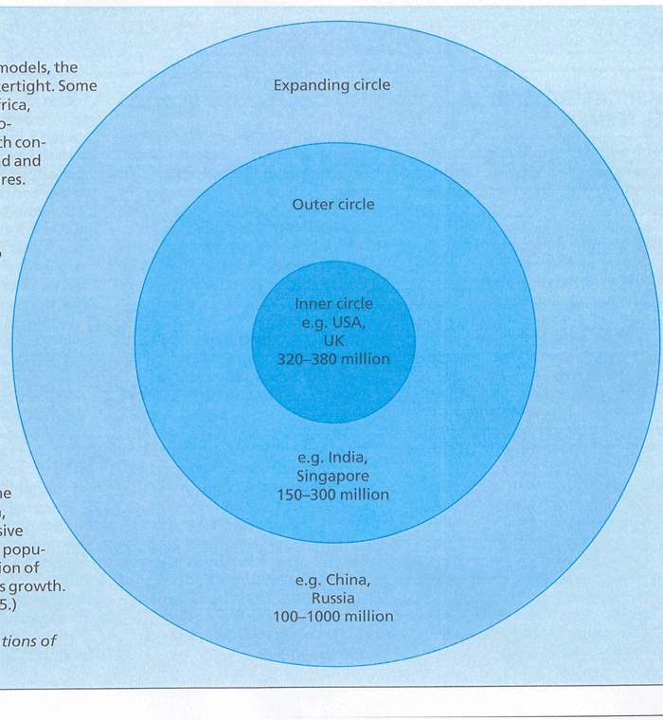
Tripartite model (B. Kachru)

Slide 60
Legal English as a Global Language: Expansion of Common Law
Some 1,200-1,500 million people in command of English; 670 million native speakers
English – official language in 75 states or administrative territories
85% international organisations use English as one of their languages
Dominance in international trade

Slide 61
Legal English in the United States
The influence of English law – terminated with the independence
Nevertheless, the approach to the legal order, fundamental principles and concepts of law, essential legal terminology - the same in England and the US

Slide 62
American legal culture
Fundamental ideas in line with the English tradition
1) supremacy of the law (rule of law)
2) rule of precedent
3) adversarial procedure

Slide 63
American legal culture
Separation between private and public law less important than in civil law countries
Separation of powers
federalism

Slide 64
Characteristics of American legal English
Institutions whose structure differs from those in England – original designation (e.g. names of courts: Federal justice system: district courts, courts of appeals, the Supreme Court)

Slide 65
Differences between UK and US English
Corporation – company
Visiting rights – right of access

Slide 66
Similarities
Traditional expressions: hereafter, herein, hereof, herewith
complexity

Slide 67
Legal English in the Indian Sub-continent: Anglo-Indian law
Common law took root alongside the traditional systems of law: Hindu law and Muslim law – application limited to traditional branches of law (family law, inheritance)
19th c. a large number of laws came into force; prepared by the British, often in London
The highest judicial organ: the Judicial Committee of the Privy Council (London)

Slide 68
Expansion and Change of legal English in India
English – language of higher education and colonial administration
1837 English became the official language in India
From 1844 only those educated in English could be appointed civil servants

Slide 69
Expansion and Change of legal English in India
Republic of India – English remains the language of higher education and science; Hindi – National Official Language
English – language of government and the higher justice system

Slide 70
Expansion and Change of legal English in India
Pakistan – Urdu
Bangladesh – Bangla (formerly: Bengali)
Legal terminology and style in India and Pakistan – essentially British
English sometimes operates as a linguistic tool even of Islamic law; differences: terms expressing original concepts of Islamic law
“In Pakistan, the language of Islamic law is in fact legislative English” (N. Ahmad)

Slide 71
Legal English in International Trade
Lawyers in non-English speaking countries daily drawing up contracts in English; often contain language similar to traditional common law contracts – serious problems
Cultural collision
Civil law lawyers may copy common law contracts without fully understanding them

Slide 72
Legal English in International Trade
“While it is open to the parties in dispute over a contract to adduce evidence as to the meaning of specific foreign words, it is not possible at common law to adduce evidence as to the actual intention of the parties when the contract was executed”

Slide 73
Contradictory interpretation
A contract in commercial law, with connectingh factors with different States is expressly submitterd or may be submitted by way of interpretation to a definite legal order
Legal disputes arising from the contract heard either by an arbitration tribunal or the courts of a State

Slide 74
Contradictory interpretation
Where litigation has to be heard by a State’s court, the interpretation may cause considerable surprise to one of the parties
A British or North American court tends to interpret the terms of a contract drawn up in English in line with traditional common law thinking
The terms may acquire a meaning completely different from that imagined by the party from a continental country
Efforts to develop terminology that is not too closely linked to the legal orders of particular States

