Slide 1
Emptio venditio – Contract of Sale
I. Main features – Arrha - Res
ROMAN PRIVATE LAW, 2016/2017
LECTURE DOC. KARLOVIĆ

Slide 2
Emptio venditio
definition - an agreement to exchange an object (res) for a price (pretium)
Main features:
Consensual – informal
iuris gentium
contractus bilateralis aequalis
contractus (iudicium) bonae fidei

Slide 3
Consensus, inter absentes
Gai. Inst. 3.135 Consensu fiunt obligationes in emptionibus et uenditionibus, locationibus conductionibus, societatibus, mandatis. 136. Ideo autem istis modis consensu dicimus obligationes contrahi, quod neque uerborum neque scripturae ulla proprietas desideratur, sed sufficit eos, qui negotium gerunt, consensisse. Unde inter absentes quoque talia negotia contrahuntur, ueluti per epistulam aut per internuntium, cum alioquin uerborum obligatio inter absentes fieri non possit.
135. Simple consent creates a contract in purchase and sale, letting and hiring, partnership, agency. 136. In these contracts consent is said to create the obligation, because no form of words or of writing is required, but the mere consent of the parties is sufficient. Absent parties, therefore, can form these contracts; as, by letter or messenger; whereas verbal obligations cannot be contracted between absent parties.

Slide 4
Consensus, inter absentes, iuris gentium
D. 18.1.1.2 (Paulus libro 33 ad edictum) Est autem emptio iuris gentium, et ideo consensu peragitur et inter absentes contrahi potest et per nuntium et per litteras.
Sale is a contract of the law of nations and so is concluded by simple agreement; it can thus be contracted by parties not present together, through messengers or by correspondence.
Ius gentium – forms found in the laws of all nations, not only in Roman law

Slide 5
Consensus – iuris gentium – origins of emptio venditio?
Prehistoric – D. 18.1.1pr. = permutatio (exchange or barter)
In Roman law – actionable informal contract of sale?
Ius civile – strict law, formal contracts; mancipatio and stipulatio
Ius gentium – praetor peregrinus 242 BC
bonae fidei iudicia – 3rd – 2nd Century BC?
sale and letting and hiring in De agricultura of Cato the Elder (234 BC – 149 BC) (aka Marcus Porcius Cato and Cato the Censor (Cato Censorius))
Quintus Mucius Scaevola (140 - 82 BC, consul 95 BC) – in Cicero′s De officiis 3,17,70

Slide 6
De officiis 3,17,70 Nam quanti verba illa: „Uti ne propter te fidemve tuam captus fraudatusve sim!“ quam illa aurea: „Ut inter bonos bene agier oportet et sine fraudatione!“ Sed, qui sint "boni" et quid sit "bene agi," magna quaestio est. Q. quidem Scaevola, pontifex maximus, summam vim esse dicebat in omnibus iis arbitriis, in quibus adderetur „ex fide bona“, fideique bonae nomen existimabat manare latissime, idque versari in tutelis, societatibus, fiduciis, mandatis, rebus emptis, venditis, conductis, locatis, quibus vitae societas contineretur; in iis magni esse iudicis statuere, praesertim cum in plerisque essent iudicia contraria, quid quemque cuique praestare oporteret.
For how weighty are the words: "That I be not deceived and defrauded through you and my confidence in you"! How precious are these "As between honest people there ought to be honest dealing, and no deception "! But who are "honest people," and what is "honest dealing" — these are serious questions. It was Quintus Scaevola, the pontifex maximus, who used to attach the greatest importance to all questions of arbitration to which the formula was appended "as good faith requires"; and he held that the expression "good faith" had a very extensive application, for it was employed in trusteeships and partnerships, in fiducias and commissions, in buying and selling, in hiring and letting — in a word, in all the transactions on which the social relations of daily life depend; in these he said, it required a judge of great ability to decide the extent of each individual's obligation to the other, especially when the counter-claims were admissible in most cases.

Slide 7
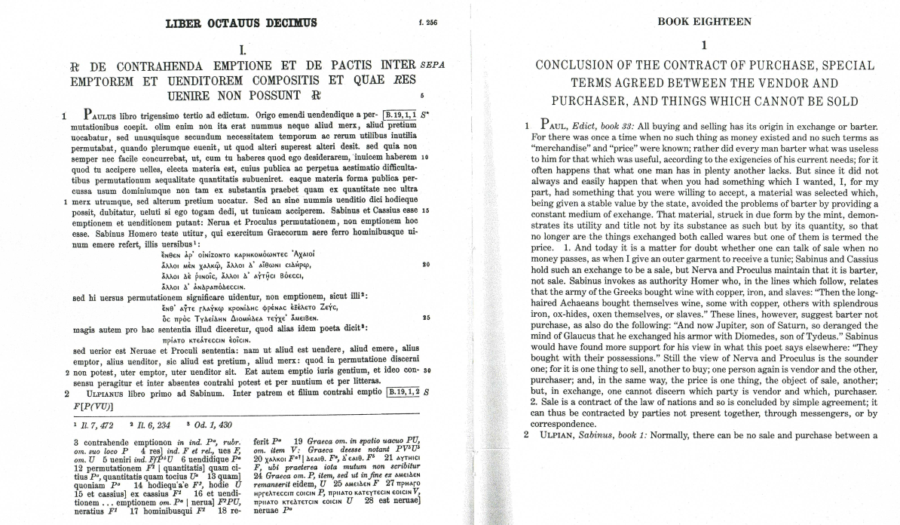

Slide 8
Consensual contracts II
Gai. Inst. 137. Item in his contractibus alter alteri obligatur de eo, quod alterum alteri ex bono et aequo praestare oportet, cum alioquin in uerborum obligationibus alius stipuletur alius promittat et in nominibus alius expensum ferendo obliget alius obligetur.
137. Further, these contracts are bilateral and bonae fidei, that is, both parties incur a reciprocal obligation to perform whatever is fair and equal; whereas verbal and literal contracts are unilateral, that is, one party stipulates and the other promises, or one party makes an entry of the other’s debit, and the other party is bound thereby.

Slide 9
Bilaterality
Contract imposes obligations on both parties
De Zulueta - „Liability of the one party depends on the other having discharged or being ready and willing to discharge his own liability”
D. 19.1.13.8 (Ulpianus libro 32 ad edictum) Offerri pretium ab emptore debet, cum ex empto agitur, et ideo etsi pretii partem offerat, nondum est ex empto actio: venditor enim quasi pignus retinere potest eam rem quam vendidit.
When an action is brought on purchase, the buyer should tender (offer) the price. Therefore if he should tender part of the price, there is not yet an action on purchase; for the seller can keep the object of sale as a sort of pledge.

Slide 10
Bilaterality - Exceptio non adimpleti contractus
Gai. Inst. 4.126a Item si argentarius pretium rei, quae in auctionem uenerit, persequatur, obicitur ei exceptio, ut ita demum emptor damnetur, si ei res, quam emerit, tradita est, et est iusta exceptio. sed si in auctione praedictum est, ne ante emptori res traderetur, quam si pretium soluerit, replicatione tali argentarius adiuuatur: AVT SI PRAEDICTVM EST, NE ALITER EMPTORI RES TRADERETVR, QVAM SI PRETIVM EMPTOR SOLVERIT.
So if a banker sue for the price of goods sold by auction, he may be met by the exception that the purchaser is only to be condemned in the action if the thing which he has bought has been delivered, and this is prima facie a just exception. But if it was a condition of the sale, that the goods should not be delivered to the purchaser before payment of the purchase-money, the banker is permitted to insert the Replicatio: ‘or if it was a condition of the sale that the goods should not be delivered till the price was paid.’

Slide 11
Bona fides - formula
Titius iudex esto,
Quod Aulus Agerius de Numerio Negidio hominem quo de agitur emit, qua de re agitur, (demonstratio)
quidquid ob eam rem Numerium Negidium Aulo Agerio dare facere oportet ex fide bona (intentio)
eius T. iudex Numerium Negidium Aulo Agerio condemnato, si non paret absolvito. (condemnatio)
Titius will be judge; whereas Aulus Agerius bought the man who is the subject of the action from Numerius Negidius, which matter is the subject of the action, whatever on account of that matter Numerius Negidius ought to give to or do for Aulus Agerius in good faith, for the value of that let the judge condemn Numerius Negidius to Aulus Agerius; if it does not appear, let him absolve.

Slide 12
De officiis 3,17,70 Nam quanti verba illa: „Uti ne propter te fidemve tuam captus fraudatusve sim!“ quam illa aurea: „Ut inter bonos bene agier oportet et sine fraudatione!“ Sed, qui sint "boni" et quid sit "bene agi," magna quaestio est. Q. quidem Scaevola, pontifex maximus, summam vim esse dicebat in omnibus iis arbitriis, in quibus adderetur „ex fide bona“, fideique bonae nomen existimabat manare latissime, idque versari in tutelis, societatibus, fiduciis, mandatis, rebus emptis, venditis, conductis, locatis, quibus vitae societas contineretur; in iis magni esse iudicis statuere, praesertim cum in plerisque essent iudicia contraria, quid quemque cuique praestare oporteret.
For how weighty are the words: "That I be not deceived and defrauded through you and my confidence in you"! How precious are these "As between honest people there ought to be honest dealing, and no deception "! But who are "honest people," and what is "honest dealing" — these are serious questions. It was Quintus Scaevola, the pontifex maximus, who used to attach the greatest importance to all questions of arbitration to which the formula was appended "as good faith requires"; and he held that the expression "good faith" had a very extensive application, for it was employed in trusteeships and partnerships, in fiducia and mandate, in buying and selling, in hiring and letting — in a word, in all the transactions on which the social relations of daily life depend; in these he said, it required a judge of great ability to decide the extent of each individual's obligation to the other, especially when the counter-claims were admissible in most cases.

Slide 13
Bona fides – contrary to any fraud in general
D. 19.1.6.8 (Pomponius libro nono ad Sabinum) Si dolo malo aliquid fecit venditor in re vendita, ex empto eo nomine actio emptori competit: nam et dolum malum eo iudicio aestimari oportet, ut id, quod praestaturum se esse pollicitus sit venditor emptori, praestari oporteat.
If the seller has done something in bad faith as regards the object of sale, the buyer has an action on the purchase concerning this; bad faith (fraud) should also be evaluated (taken into account) in this action, in order that the seller be held responsible to the buyer for what he promised to perform.
Dolus – knowingly selling res extra commercium, object with other qualities than proclaimed/agreed on

Slide 14
Bona fides - in general
D. 19.1.11.1 (Ulpianus libro 32 ad edictum) Et in primis sciendum est in hoc iudicio id demum deduci, quod praestari convenit: cum enim sit bonae fidei iudicium, nihil magis bonae fidei congruit quam id praestari, quod inter contrahentes actum est. Quod si nihil convenit, tunc ea praestabuntur, quae naturaliter insunt huius iudicii potestate.
The first point to be noted is that included in this action is only what the parties agreed to be held responsible for. This is an action of good faith, and nothing better conforms to good faith than that the contracting parties be held responsible for what they arranged. But if nothing was agreed on, then they are held responsible for the duties naturally inheriting in the scope of this action.

Slide 15
Consensus revisited
Agreement on res and pretium – was it sufficient?

Slide 16
Consensus and the price:
Arr(h)a (earnest money)
Gai. Inst. 3.139 Emptio et uenditio contrahitur, cum de pretio conuenerit, quamuis nondum pretium numeratum sit ac ne arra quidem data fuerit. nam quod arrae nomine datur, argumentum est emptionis et uenditionis contractae.
The contract of purchase and sale is complete so soon as the price is agreed upon and before the price or any earnest money is paid. The earnest money is merely evidence of the completion of the contract.
D. 18.1.35pr. (Gaius libro decimo ad edictum provinciale) Quod saepe arrae nomine pro emptione datur, non eo pertinet, quasi sine arra conventio nihil proficiat, sed ut evidentius probari possit convenisse de pretio.
The common practice of giving earnest in respect of a purchase does not suggest that without the earnest there would be no contract, but facilitates proof of the fact of agreement on the price.

Slide 17
Arr(h)a
Greek arrha – prerequisite for creating the obligation
In classical Roman law only the evidence
In Justinianic law – proclaimed evidentiary role, however was it really arrha poenitentialis?
Just. Inst. 3.23pr. and C. 4.21.17.2. – unclear sequence

Slide 18
Just. Inst. 3.23pr.
Emptio et venditio contrahitur, simulatque de pretio convenerit, quamvis nondum pretium numeratum sit ac ne arra quidem data fuerit. nam quod arrae nomine datur argumentum est emptionis et venditionis contractae. sed haec quidem de emptionibus et venditionibus quae sine scriptura consistunt obtinere oportet: nam nihil a nobis in huiusmodi venditionibus innovatum est. in his autem quae scriptura conficiuntur non aliter perfectam esse emptionem et venditionem constituimus, nisi et instrumenta emptionis fuerint conscripta vel manu propria contrahentium, vel ab alio quidem scripta, a contrahente autem subscripta et, si per tabellionem fiunt, nisi et completiones acceperint et fuerint partibus absoluta. donec enim aliquid ex his deest, et poenitentiae locus est et potest emptor vel venditor sine poena recedere ab emptione. ita tamen impune recedere eis concedimus nisi iam arrarum nomine aliquid fuerit datum: hoc etenim subsecuto, sive in scriptis sive sine scriptis venditio celebrata est, is qui recusat adimplere contractum, si quidem emptor est, perdit quod dedit, si vero venditor, duplum restituere compellitur, licet nihil super arris expressum est.
The contract of purchase and sale is complete immediately the price is agreed upon, and even before the price or as much as any earnest is paid: for earnest is merely evidence of the completion of the contract. In respect of sales unattested by any written evidence this is a reasonable rule, and so far as they are concerned we have made no innovations. By one of our constitutions, however, we have enacted, that no sale effected by an agreement in writing shall be good or binding, unless that agreement is written by the contracting parties themselves, or, if written by some one else, is at least signed by them, or finally, if written by a notary, is duly drawn by him and executed by the parties. So long as any of these requirements is unsatisfied, there is room to retract, and either purchaser or vendor may withdraw from the agreement with impunity – provided, that is to say, that no earnest has been given. Where earnest has been given, and either party refuses to perform the contract, that party, whether the agreement be in writing or not, if purchaser forfeits what he has given, and if vendor is compelled to restore double of what he has received, even though there has been no express agreement in the matter of earnest.

Slide 19
C. 4.21.17.2 (Imperator Justinianus, 528 AD)
Illud etiam adicientes, ut et in posterum, si quae arrae super facienda emptione cuiuscumque rei datae sunt sive in scriptis sive sine scriptis, licet non sit specialiter adiectum, quid super isdem arris non procedente contractu fieri oporteat, tamen et qui vendere pollicitus est, venditionem recusans in duplum eas reddere cogatur, et qui emere pactus est, ab emptione recedens datis a se arris cadat, repetitione earum deneganda.
We also add that if any earnest money is hereafter paid in connection with the intended purchase of any property, whether accompanied by writing or not, then, although no special agreement is made of what shall become of such money if the contract is not performed, the person promising to sell must, upon refusal to do so, restore double what he has received, and the person promising to buy must, upon refusal to do so, lose the amount paid, without right to reclaim it.

Slide 20
C. 4.21.17pr.-1
Contracts of sale, exchange or gift, which need not be registered, and contracts of earnest money, or of any other transaction, which are agreed to be put in writing, and contracts of compromises which, pursuant to agreement, are to be evidenced by a written document, shall have no effect until the final clean draft of the document has been drawn, and they have been confirmed by the parties by their signatures, and until, if such documents are written by a notary, they shall be completed (completa) by him and afterwards declared ready for delivery to the (respective) parties (absoluta), so that no one shall have permission to claim any right under such contract or compromise until these things are done, whether such claim is made under a contract still in rough draft, though signed by one or both of the parties, or under a contract of which the final draft has been made, but which has not yet been completed and declared ready for delivery to the (respective) parties. This is true to the extent that in purchases in this manner, even where the price is agreed on, it cannot be said that the vendor must complete his contract of sale or pay to the purchaser his damage.
1. This shall apply to instruments hereafter to be completed, as well as to those which have been already written but have not yet been executed, unless a compromise or legal adjudication, which cannot be reopened, has taken place; excepting herefrom only instruments of purchase already written in rough draft (in scheda), or in final draft (in mundo), to which the present law shall not extend, but we permit the former laws to govern them.

Slide 21
Consensus and res (the object of sale)

Slide 22
Dissensus – Error - Mistake
D. 44.7.57 (Pomponius libro 36 ad Quintum Mucium) In omnibus negotiis contrahendis, sive bona fide sint sive non sint, si error aliquis intervenit, ut aliud sentiat puta qui emit aut qui conducit, aliud qui cum his contrahit, nihil valet quod acti sit.
In all the legal affairs, whether they were bonae fidei or not, if there is any mistake, if the one who buys or hires thinks one thing, and the other person with whom he concludes the contract the other, it is not valid what was agrred on.

Slide 23
D. 18.1.9pr.-2 (Ulpianus 28 ad Sabinum) pr. In venditionibus et emptionibus consensum debere intercedere palam est: ceterum sive in ipsa emptione dissentient sive in pretio sive in quo alio, emptio imperfecta est. si igitur ego me fundum emere putarem Cornelianum, tu mihi te vendere Sempronianum putasti, quia in corpore dissensimus, emptio nulla est. idem est, si ego me Stichum. Tu Pamphilum absentem vendere putasti: nam cum in corpore dissentiatur, apparet nullam esse emptionem. 1. Plane si in nomine dissentiamus, verum de corpore constet, nulla dubitatio est, quin valeat emptio et venditio: nihil enim facit error nominis, cum de corpore constat. 2. Inde quaeritur, si in ipso corpore non erratur, sed in substantia error sit, ut puta si acetum pro vino veneat, aes pro auro vel plumbum pro argento vel quid aliud argento simile, an emptio et venditio sit. Marcellus scripsit libro sexto digestorum emptionem esse et venditionem, quia in corpus consensum est, etsi in materia sit erratum. ego in vino quidem consentio, quia eadem prope ousia est, si modo vinum acuit: ceterum si vinum non acuit, sed ab initio acetum fuit, ut embamma, aliud pro alio venisse videtur. in ceteris autem nullam esse venditionem puto, quotiens in materia erratur.
It is obvious that there has to be consent in contracts of sale. Otherwise, if parties disagree either about the nature of the contract or about the price or about something else, the sale is not valid. Hence, if I thought that I was buying the Cornelian farm and you that you were selling teh Sempronian, the sale is void because we were not agreed upon the thing sold. The same is true if I intended to sell Stichus and you thought that I was selling you pamphilus, the slave himself not being there; because there is no agreement on the object of sale, there is manifestly no sale.

Slide 24
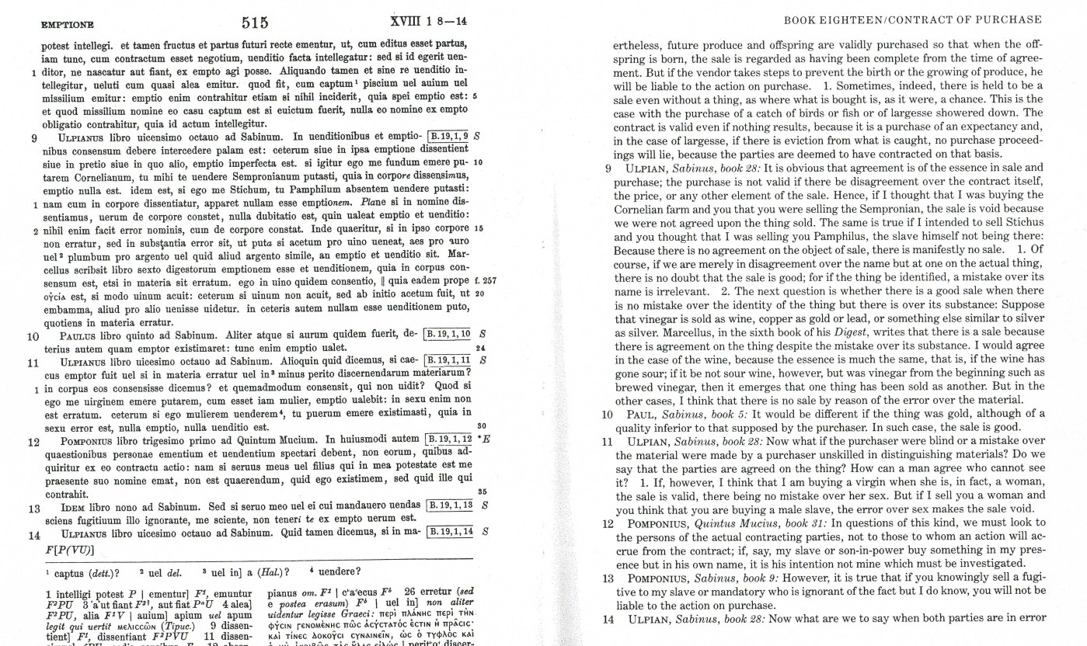

Slide 25
Res or merx
The object of sale

Slide 26
What can be the object of sale…
every object that can be owned, but also servitudes and rights arising from obligations
had to be specified – existing or future, but not that have already perished („impossibilium nulla obligatio est”)
D. 18.1.34.1 (Paulus 33 ad edictum) Omnium rerum, quas quis habere vel possidere vel persequi potest, venditio recte fit: quas vero natura vel gentium ius vel mores civitatis commercio exuerunt, earum nulla venditio est.
There can be a valid sale of anything which one may have, possess, or sue for; but there can be no sale of anything which is excluded from commercium by natural law, the law of nations or the customs of the state.

Slide 27
(Res futurae – emptio rei speratae - conditional sale)
D. 18.1.8pr. (Pomponius 9 ad Sabinum) Nec emptio nec venditio sine re quae veneat potest intellegi. Et tamen fructus et partus futuri recte ementur, ut, cum editus esset partus, iam tunc, cum contractum esset negotium, venditio facta intellegatur: sed si id egerit venditor, ne nascatur aut fiant, ex empto agi posse.
pr. There can be no sale without a thing to be sold. Nevertheless, future produce and offspring are validly purchased so that when the offspring is born, the sale is regarded as having been complete from the time of agreement. But if the vendor takes stops to prevent the birth or the growing of produce, he will be liable to the action on purchase.

Slide 28
(Res futurae – emptio spei - unconditional sale)
D. 18.1.8.1. (Pomponius 9 ad Sabinum) Aliquando tamen et sine re venditio intellegitur, veluti cum quasi alea emitur. Quod fit, cum captum piscium vel avium vel missilium emitur: emptio enim contrahitur etiam si nihil inciderit, quia spei emptio est: et quod missilium nomine eo casu captum est si evictum fuerit, nulla eo nomine ex empto obligatio contrahitur, quia id actum intellegitur.
Sometimes, indeed, there is held to be a sale even without a thing, as where what is bought is, as it were, a chance. This is the case with the purchase of a catch of birds or fish or of largesse showered down. The contract is valid even if nothing results, because it is a purchase of an expectancy and, in the case of largesse, if there is eviction from what is caught, no purchase proceedings will lie, because the parties are deemed to have contracted on that basis.

Slide 29
(Emptio rei suae)
D. 50.17.45pr. (Ulpianus 30 ad edictum) Neque pignus neque depositum neque precarium neque emptio neque locatio rei suae consistere potest.
Neither pledge nor safekeeping nor precarium nor sale nor letting can consist of our own thing.
D. 18.1.16 (Pomponius 9 ad Sabinum) pr. Suae rei emptio non valet, sive sciens sive ignorans emi: sed si ignorans emi, quod solvero repetere potero, quia nulla obligatio fuit. 1. Nec tamen emptioni obstat, si in ea re usus fructus dumtaxat ementis sit:
pr. Regardless of the purchaser's state of knowledge, purchase of one's own property is void; but if he bought in ignorance, he can recover the price he paid, because he was under no obligation. 1. There is, though, no bar to the purchase if the purchaser presently has only a usufruct in the thing.
D. 18.1.34.4 (Paulus 33 ad edictum) Rei suae emptio tunc valet, cum ab initio id agatur, ut possessionem emat, quam forte venditor habuit, et in iudicio possessionis potior esset.

Slide 30
… and what cannot?
GENERAL RULE – THERE CAN BE NO VALID SALE OF FREEDMAN, RES EXTRA COMMERCIUM – ESP. RES SACRAE, RELIGIOSAE
D. 18.1.8.2. Liberum hominem scientes emere non possumus. Sed nec talis emptio aut stipulatio admittenda est: "cum servus erit", quamvis dixerimus futuras res emi posse: nec enim fas est eiusmodi casus exspectare.
We cannot knowingly buy a freeman, nor is a sale or stipulation allowed with the provision „when he shall become a slave”, even though we have said that the sale of future things is possible, for it is contrary to morality to anticipate such a contingency.

Slide 31
HOWEVER, …
D. 18.1.4 (Pomponius 9 ad Sabinum) Et liberi hominis et loci sacri et religiosi, qui haberi non potest, emptio intellegitur, si ab ignorante emitur. (The purchase of a freedman or of a sacred or religious land who or which cannot be held as property is considered valid, so long as the purchaser does not know.)
D. 18.1.62 (Modestinus 5 regularum) Qui nesciens loca sacra vel religiosa vel publica pro privatis comparavit, licet emptio non teneat, ex empto tamen adversus venditorem experietur, ut consequatur quod interfuit eius, ne deciperetur. (If a person unwittingly buys sacred, religious or public land as being private, then, although there is no valid purchase, he can nonetheless have the action on purchase against his vendor for the damages he has suffered through being deceived.)
RESPONSIBILITY FOR DAMAGES –negative or positive interest?
D. 18.1.6pr. (Pomponius 9 ad Sabinum) Sed Celsus filius ait hominem liberum scientem te emere non posse nec cuiuscumque rei si scias alienationem esse: ut sacra et religiosa loca aut quorum commercium non sit, ut publica, quae non in pecunia populi, sed in publico usu habeatur, ut est Campus Martius.
(However, Celsus younger says that you cannot wittingly buy a freeman or anything, the alienation of which you know to be forbidden; for instance, sacred or religious land or land excluded from private dealings, such as those public lands which are not in the public purse but are for public ue, such as the Field of Mars.)

Slide 32
Responsibility regarding the sale of res extra commercium and culpa in contrahendo
RESPONSIBILITY FOR DAMAGES
negative or positive interest?
Modestinus - "quod interfuit eius ne deciperetur” vs. Justinianus – „quod sua interest deceptum eum non esse”
Just. Inst. 3.23.5 Loca sacra vel religiosa, item publica, veluti forum basilicam, frustra quis sciens emit, quas tamen si pro privatis vel profanis deceptus a venditore emerit, habebit actionem ex empto, quod non habere ei liceat, ut consequatur, quod sua interest deceptum eum non esse. idem iuris est, si hominem liberum pro servo emerit.

