Slide 1
English for Lawyers 2
Lecturer: Miljen Matijašević
e-mail: miljen.matijasevic@gmail.com
Session 8, 4 May 2018

Slide 2
Revision
The Executive Branch in the USA

Slide 3
The Executive Branch in the USA
What is the main role of the president of the USA?
What are the requirements for presidency?
What do you know about the election procedure for the president of the USA?
What types of powers does the president have? Say something about each type.
What are the functions of the VP?
What about the EOP?
Is the US Cabinet essentially the same as the British one in terms of organisation?

Slide 4
The Supreme Court of the US
Unit 17

Slide 5
The Supreme Court of the United States
The highest judicial authority in the USA
Supreme Court building: 1, First Street, Washington, DC
Chief Justice of the USA: John G. Roberts, Jr.
8 Associate Justices
Set up pursuant to the Constitution and the Judiciary Act (1789) in February 1790

Slide 6
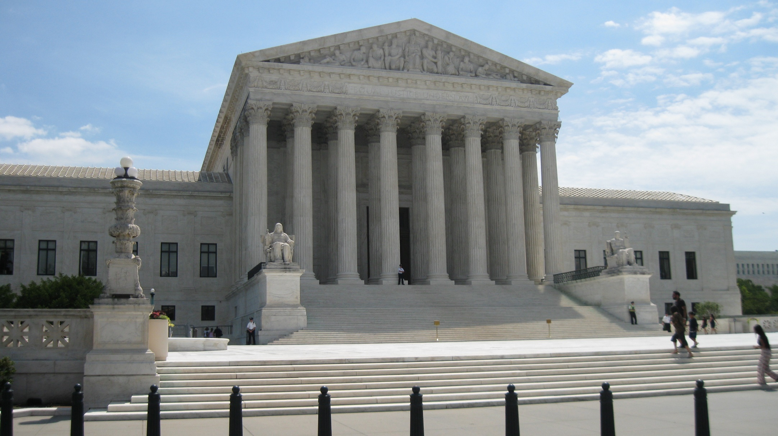
US Supreme Court

Slide 7
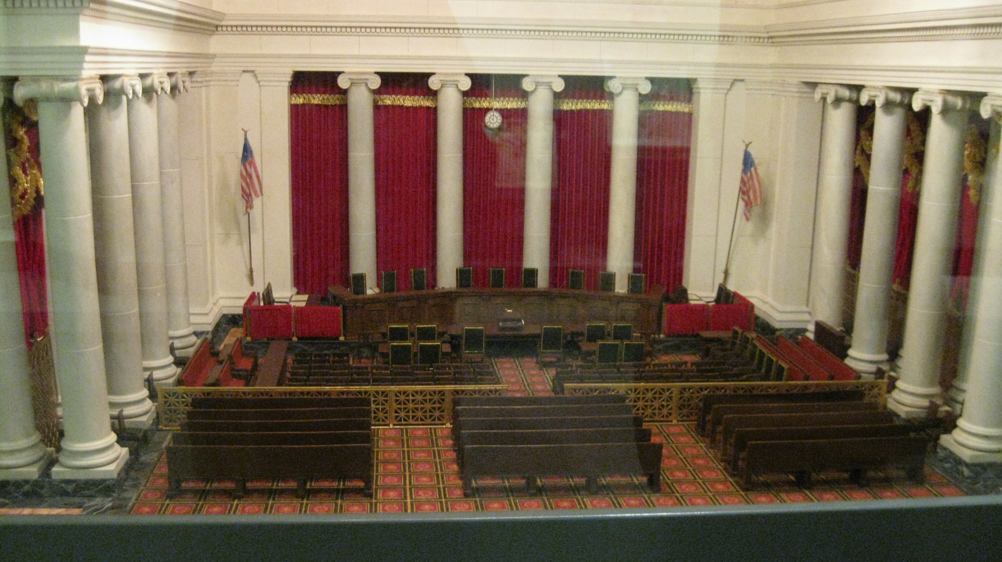
The Courtroom

Slide 8
The Supreme Court of the US
Supreme Court justices nominated by the President and appointed with the ‘advice and consent’ of the Senate
SC Justices hold their offices for life (‘during good Behaviour’)
According to the Constitution, the salaries of Supreme Court justices may not be cut
They are removed from office only upon conviction on impeachment.
They may also retire (after the age of 70) or resign

Slide 9
Jurisdiction (SC of the US)
From Article III of USC
“The judicial Power shall extend to all Cases, in Law and Equity, arising under this Constitution, the Laws of the United States, and Treaties made, or which shall be made, under their Authority;—to all Cases affecting Ambassadors, other public Ministers and Consuls;—to all Cases of admiralty and maritime Jurisdiction;—to Controversies to which the United States shall be a Party;—to Controversies between two or more States;—between a State and Citizens of another State;—between Citizens of different States;—between Citizens of the same State claiming Lands under Grants of different States, and between a State, or the Citizens thereof, and foreign States, Citizens or Subjects.”

Slide 10
Jurisdiction (SC of the US)
From Article III of USC (cont.)
“In all Cases affecting Ambassadors, other public ministers and Consuls, and those in which a State shall be Party, the supreme Court shall have original Jurisdiction. In all the other Cases before mentioned, the supreme Court shall have appellate jurisdiction, both as to Law and Fact, with such Exceptions, and under such Regulations as the Congress shall make.”

Slide 11
The Supreme Court of the US
The Court often referred to after the name of the judge presiding over it (the current Court – the Roberts Court)
Its scope of work developed through history, through various precedents
Guardian of the Constitution and federal law, correcting interpretations of the Constitution made by state courts, supervision of the development of federal law

Slide 12
The Supreme Court of the US
The Court hears appeals on decisions made by:
  Federal courts of appeal (circuit courts)
  State supreme courts
    if it concerns issues relating to (the interpretation of) the federal Constitution

Slide 13
The Supreme Court of the US
The Court, i.e. the Justices generally perceived as either conservative or liberal
NOMINATION – nearly all presidents have had the opportunity to nominate a SC justice
They usually choose somebody with similar political views
No constitutional restrictions or requirements for the nomination; however, the Senate must approve the choice

Slide 14
The Supreme Court of the US
CONFIRMATION by the Senate – lasts longer than in the past
SC justices seen as exerting rather important political power
Nominees interviewed by the Senate Judiciary Committee before the voting
Only 12 nominees have been rejected in history, but some nominations have been withdrawn before the vote
The confirmation process often topic of public debate, subject to lobbying

Slide 15
The Supreme Court of the US
PETITIONS for a ‘writ of certiorari’, or ‘cert’ is filed to the Court for judicial review
The Court may only review "final judgments rendered by the highest court of a state in which a decision could be had" if those judgments involve a question of federal statutory or constitutional law
PETITIONER – the party that lost in the trial
RESPONDENT – the party that won

Slide 16
The Supreme Court of the US
Cert petitions assessed at conferences (meetings of all 9 justices, without clerks)
Over 7,000 petitions received each year – only about a 100 granted
If granted, parties invited to submit briefs about the merits of the case
Oral arguments are heard
With the consent of the parties and the Court, amici curiae may also present briefs (these are individuals who are invited to present relevant information or a learned treatise as to the points of law, or a testimony that has not been solicited by either of the parties)

Slide 17
The Supreme Court of the US
After oral arguments, the case is submitted for decision
Decisions reached by a majority vote
The most senior judge drafts the initial opinion
Opinions circulated among the justices – both concurring and dissenting
  CONCURRING OPINION –one agreeing with the majority
  DISSENTING OPINION – one disagreeing with the majority
In practice, decisions reached and published by the end of the Court’s current term (terms last from October to October)

Slide 18
The Supreme Court of the US
Usually the entire Court decides, but a quorum of six is required (this may be due to recusals or vacancies)
A justice may recuse himself/herself if there is a conflict of interest
If there is an even split in opinions, than the ruling of the lower court is affirmed, but the decision will not become a binding precedent

Slide 19
The Supreme Court of the US
The Supreme Court can overturn laws and executive decisions
It can establish precedents that are innovative and go beyond statutes, as long as they are in line with the Constitution
Justices serve life terms and their pay may not be diminished
Many see this as too much power lying in the hands of the Court and too few mechanisms of control
However, the Congress has the power to limit the jurisdiction of the Court, as laid down in the Constitution, and can enact statutes that will override their decisions

Slide 20
The Supreme Court of the US
Some criticise the so-called ‘judicial activism’, i.e. the tendency for the court to shape laws, instead of just interpreting them
Doubts about the clarity of the separation of powers
The Court has been accused of either conservative or liberal judicial activism throughout its history
Activism seen as departure from the literal interpretation of the Constitution in pursuit of what the Court considers to be right or reasonable

Slide 21
The Supreme Court of the US
Example of conservative criticism of the Supreme Court, by Pat Buchanan, 2005, referring to the Warren Court (1953-1969):
“It invented new rights for criminals and put new restrictions on cops and prosecutors. (...) It ordered God, prayer and Bible-reading out of classrooms. It said pornography was constitutionally protected, making Larry Flynt and Al Goldstein First Amendment heroes, rather than felons. It ruled naked dancing a protected form of free expression. It declared abortion a constitutional right and sodomy constitutionally protected behavior. It outlawed the death penalty, abolished term limits on members of Congress voted by state referendums, and told high school coaches to stop praying in locker rooms and students to stop saying prayers at graduation. It ordered the Ten Commandments out of schoolhouses and courthouses. (...)”

Slide 22
US Federal Courts

Slide 23
US Federal Courts
Courts set up under federal law of the United States
No provision for a federal court system in the Constitution, apart from the Supreme Court
The federal court system established by Congress
General jurisdiction courts:
  Supreme Court of the United States
  United States courts of appeal (circuit courts)
  United States district courts

Slide 24
US Federal Courts
Courts of specific subject-matter jurisdiction:
  United States bankruptcy courts
  United States Tax Court
  United States Court of Private Land Claims
  United States Court of International Trade
  United States Court of Federal Claims
  United States Court of Appeals for Veterans Claims
  United States Court of Appeals for the Armed Forces
  United States Court of Appeals for the Federal Circuit
  United States Foreign Intelligence Surveillance Court

Slide 25
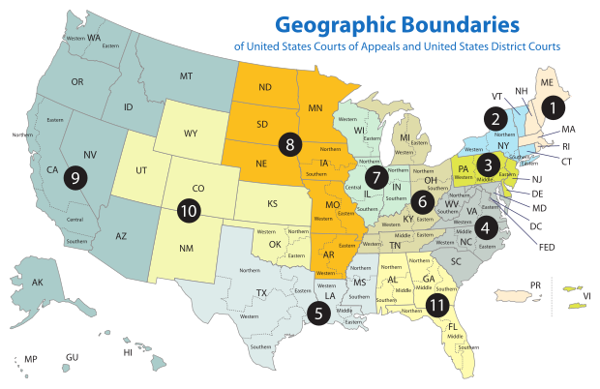
US Circuits and Districts

Slide 26
US Districs Courts
89 districts in the 50 states (plus 5 more for the territories)
Exclusive jurisdiction over criminal cases, and civil cases (apart from the ones reserved for specialized courts)
Not any case can come before a federal district court

Slide 27
US Districs Courts
ORIGINAL JURISDICTION in the following types of cases:
civil actions arising under the Constitution, laws, and treaties of the United States
certain civil actions between citizens of different states
civil actions within the admiralty or maritime jurisdiction of the United States
criminal prosecutions brought by the United States
civil actions in which the United States is a party, etc.

Slide 28
US Districs Courts
Important notion: DIVERSITY JURISDICTION
Relevant to civil cases
Parties to a civil proceeding must be diverse, i.e. have citizenship of different states (or countries)
Additional requirement – the amount claimed must exceed the sum or value of $75,000
Claims against the same defendant may be accumulated to meet the amount but different claimants may not join their claims in order to meet this requirement
The claims undergo a ‘legal certainty’ test – if it is established that the claimant cannot legally obtain more than $75,000, the claim is refused

Slide 29
US Districs Courts
A case filed in a state court may be removed by the defendant to a federal court, provided that it meets the above mentioned requirements
Substantive law applied in federal trials is the law of the state in which the lawsuit was filed
Procedural rules are subject to Federal Rules of Civil Procedure and the Federal Rules of Evidence

Slide 30
US Districs Courts
District judges – appointed by the President (subject to approval by the Senate)
Will usually share some of the President’s views and the choice often influenced by the State Senator, if he or she comes from the same party as the President
Appointed to life terms, although they may choose to retire at 65
Otherwise, they may choose ‘senior status’ and do occasional work, as assigned by the chief district judge
Magistrate judges – handle simple cases, and can be fired at any time for any rational reason, as any other court employee

Slide 31
US Courts of Appeal
Also known as circuit courts
Circuits include several districts and circuit courts have jurisdiction over appeals against pertinent district court decisions
There are 11 circuits (plus 2 specialized)
Trials not conducted at circuit courts
Deal only with ‘briefs’ – oral arguments may be permitted, but only legal representatives allowed to speak to the court
Procedure governed by the Federal Rules of Appellate Procedure
Appeals court decisions are binding precedents

Slide 32
Discuss the following vocabulary items!
Chief Justice
Associate Justice
original jurisdiction
appellate jurisdiction
nomination
confirmation
cert petition
petitioner
respondent
final judgment
amici curiae
concurring opinion
dissenting opinion
recusal
judicial activism
district court
circuit court
diversity jurisdiction
legal certainty test

Slide 33
Thank you for your attention!

