Slide 1
English for Lawyers 2
Lecturer: Miljen Matijašević
e-mail: miljen.matijasevic@gmail.com
Session 8, 4 May 2018

Slide 2
Revision
American Federalism

Slide 3
Revision – American Federalism
What do you know about the political organisation of the United States of America?
Why did the 13 British colonies in America seek independence from Britain? When and how did they achieve this?
What is federalism, in the context of the USA?
What is the Congress? How is it organised?
What powers of the Congress do you know?

Slide 4
The Executive Branch in the USA
Unit 12

Slide 5
The Executive (the USA)
Executive power in the USA lies in the hands of the President of the United States
Responsible for implementing laws enacted by Congress
The Cabinet – heads of 15 executive departments (14 Secretaries and Attorney General – head of the Department of Justice)
Advisory body assisting the President

Slide 6
The President
Head of government and Commander-in-Chief of the armed forces
In addition to the 15 departments, agencies, such as the CIA and Environmental Protection Agency, all operate under President’s authority
President also appoints heads of independent federal commissions, federal judges and ambassadors

Slide 7
The President
Legislative function – final step in the enactment of laws – President’s signature
He may decide to veto a bill – in that case, the Congress can only override the veto by a two-thirds majority in both houses

Slide 8
The President
Diplomatic function – negotiating and signing international agreements (must be ratified by the Senate)
Issues executive orders for the implementation of laws enacted by the Congress

Slide 9
The President
Judicial function – has the power to give pardons for federal crimes, except impeachment
nomination of federal court judges, including Supreme Court justices

Slide 10
The President
Reporting to Congress: usually once a year, the President gives the State of the Union address, outlining the situation in the country and their legislative agenda for the coming year
Traditionally given in January, except in election years

Slide 11
The President
Requirements for presidential candidates:
  Must be at least 35 years of age
  Must be a natural born citizen
  Must have lived in the USA for at least 14 years.
A president may only serve two four-year terms (since 1951 – before that there was no limit)
Current President: Barrack Obama (44th President of the United States)

Slide 12
The President
Resides in the White House – official residence of the President, in Washington DC
Oval Office – the office of the President, also located in the White House
Air Force One – the plane the President uses to travel – only referred to as AFO when the President is on board

Slide 13
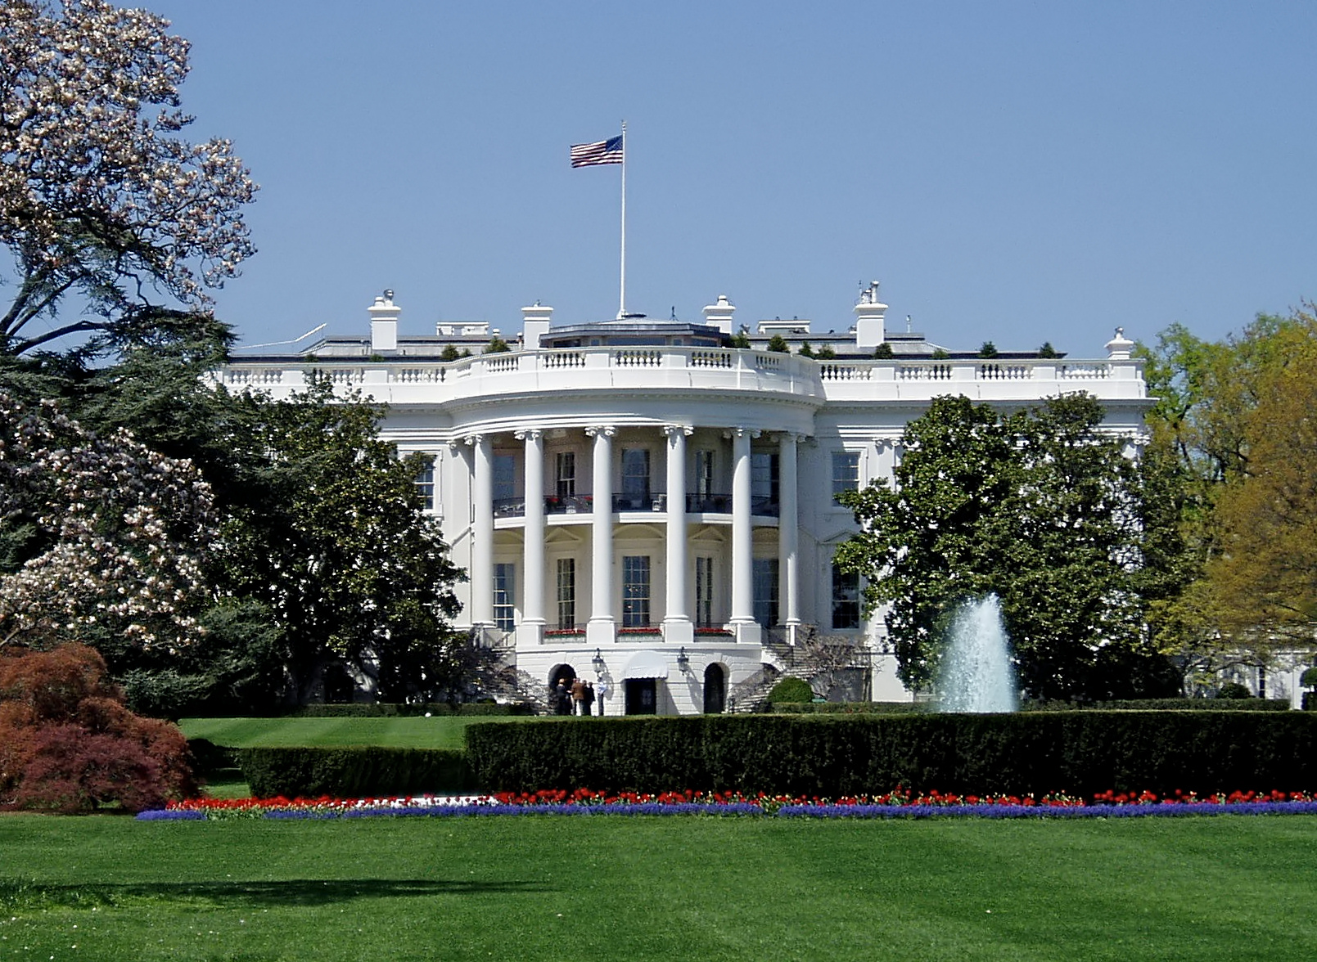
The White House

Slide 14
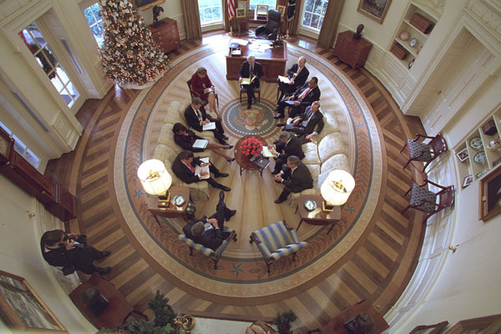
The Oval Office

Slide 15
The Vice President
Presides over the US Senate
His duty is to be ready to assume Presidency at any moment should the President not be able to perform the presidential duties
The Vice President is also elected in presidential election

Slide 16
The Vice President
Situations in which the VP assumes Presidency:
  the President’s death,
  resignation,
  temporary incapacitation, or
  if the VP and a majority of the Cabinet decide that the President is no longer capable to perform his presidential duties

Slide 17
Impeachment
Removal from office of a federal offical by Congress (including the President)
House of Representatives prosecutes, the Senate tries
  a simple majority in the House is required to impeach an official
  a two-thirds majority in the Senate is required for conviction
  a convicted official automatically removed from office
  in addition, the Senate may stipulate that the defendant be banned from holding office in the future.

Slide 18
Executive Office of the President (EOP)
Headed by the White House Chief of Staff, assists the President in the discharge of his duties
Body of the President’s closest advisors, contains numerous offices (such as the White House Communications Office, the National Security Council)
Advises the President and provides logistical support

Slide 19
The Cabinet
Advisory body made up of the heads of the 15 executive departments
Appointed by the President, confirmed by the Senate

Slide 20
The Cabinet
The Departments are as follows:
  Agriculture,
  Commmerce,
  Defense,
  Education,
  Energy,
  Health and Human Services,
  Homeland Security,
  Housing and Urban Development,
  the Interior,
  Justice,
  Labor,
  Department of State (foreign affairs),
  Transportation,
  the Treasury, and
  Veterans Affairs

Slide 21
Presidential Elections

Slide 22
Presidential elections
Held every four years on the first Tuesday after the first Monday in November
US presidential elections are INDIRECT
  People vote for members of the Electoral College, which then, in turn, elects the President and the Vice President

Slide 23
Presidential elections
State elections (popular vote) – each state votes for members of the Electoral College (these elections regulated by each state legislature)
The number of members per state equals the number of representatives of each state in the Congress (House+Senate)
Washington DC is allocated the same number of members in the EC as the least populous state (i.e. 3)

Slide 24
Presidential elections
Election Day – Popular Vote – voters vote for the slate of electors which has pledged to vote for a certain presidential candidate
Electors vote for the candidate they have pledged for (electoral vote), but occasionally there are ‘faithless electors’ – vote for a different candidate than the one they have pledged for
24 states have laws to punish ‘faithless electors’ (others do not!)

Slide 25
Presidential elections
HISTORY – this two-step system is the result of a compromise between two proposed election systems:
  direct popular vote
  election by Congress
In the past, information about candidates coming from other states was largely unavailable or insufficient, so it was preferred that a selected few vote for the President himself
Nowadays, this reason is no longer applicable
There have been proposals of constitutional amendments to introduce direct popular vote, but none have been adopted

Slide 26
Presidential elections
Once set up, the Electoral College votes for the president and the vice president, casting separate votes for each
In 93 percent of cases, the result of the popular vote matches the result of the electoral vote
However, there are exceptions, such as the 2000 elections when George W. Bush lost the popular vote but won the majority of electoral votes (the infamous Florida Recount), and the 2016 elections when Donald Trump was elected

Slide 27
Presidential elections
Nominees for the President and the Vice President are selected at national presidential nominating conventions by each political party
These are preceded by primary elections (run by state and local governments) or caucuses (organized by political parties) – depending on the state

Slide 28
Presidential elections
The point of primaries and caucuses is to select delegates to attend the national party convention and vote for a particular presidential candidate
System largely similar to the indirect voting system in the presidential election

Slide 29
Discuss the following vocabulary items!
Commander-in-Chief of the armed forces
to veto a bill
to override the veto
pardon (for a crime)
State of the Union Address
to take office/to leave office
to be removed from office
incapacitation
Department of State
Electoral College
the slate (of electors)
to pledge to vote
faithless elector
popular vote
electoral vote
primary elections/caucuses

Slide 30
Translation practice

Slide 31
Translation exercise
Unlike most other countries using the presidential system, Presidents are elected indirectly in the United States. A number of electors, collectively known as the Electoral College, officially select the President. Each state is allocated a number of electors, equal to the size of its delegation in both Houses of Congress combined. Additionally, the Twenty-third Amendment grants electors to the District of Columbia as if it were a state, with the restriction that it may not have more representation than the least populated state. Electoral apportionment is adjusted every ten years, in alignment with the census. State legislatures are constitutionally empowered to appoint electors; however, all of the fifty states have established their popular selection.

Slide 32
Translation exercise
Za razliku od većine drugih zemalja s predsjedničkim sustavom, u Sjedinjenim Državama predsjednik se bira posredno. Određen broj izbornika, koji čine tzv. Izborni kolegij, službeno biraju predsjednika. Svaka država ima pravo izabrati određen broj izbornika, koji odgovara ukupnom broju njezinih zastupnika u oba doma Kongresa. Uz to, prema 23. amandmanu, Okrug Columbia (District of Columbia) ima pravo birati izbornike kao i ostale države, usto da ne smije imati više predstavnika u Izbornom kolegiju od savezne države s najmanjim brojem stanovnika. Državna zakonodavna tijela imaju ustavnu ovlast za imenovanje izbornika. Međutim, svih pedeset država uspostavili su sustav izbora od strane građana.

Slide 33
Translation exercise
The President, further, can propose legislation to Congress, and call it to Washington for special sessions additional to those provided for in the Constitution. He can also address it by message, or in person, when he wishes; and he has the certainty, on these occasions, that most citizens of the United States will be giving their attention to what he has to say. He can also veto legislation passed by Congress; and, in that event, no bill becomes law unless it is passed again by Congress with a two-thirds majority in its favour in each House.

Slide 34
Translation exercise
Nadalje, predsjednik može Kongresu iznositi zakonodavne prijedloge te ga sazivati u Washington na posebne sjednice, pored onih propisanih Ustavom. Može mu se isto tako obratiti poslanicom ili osobno, kad god to poželi; ako to učini, može računati na pozornost većine građana/državljana Sjedinjenih Država. Predsjednik može uložiti veto na zakonodavne prijedloge koje usvoji Kongres. U tome slučaju prijedlog zakona može postati zakon samo ako ga Kongres ponovno usvoji, i to dvotrećinskom većinom glasova u korist prijedloga u oba doma Kongresa.

Slide 35
Thank you for your attention!

