Slide 1
English for Lawyers 2
Lecturer: Miljen Matijašević
e-mail: miljen.matijasevic@gmail.com
Session 7, 17 Apr 2018

Slide 2
Revision
The Legal Profession

Slide 3
The Legal Profession
Remember the difference between solicitors and barristers
Exercise 87/III, 88/IV

Slide 4
The United States of America
Birth and Constitution

Slide 5
The United States of America

Slide 6
The United States of America
Capital: Washington, D.C. (largest city: New York City)
Population: 306 million, Area: 9,8m km²
Government: Federal constitutional republic comprising 50 states (48 continental + Alaska and Hawaii) and 1 federal district (District of Columbia)

Slide 7
The USA – the beginnings
Founded by 13 British colonies who rebelled against British rule
The Thirteen Colonies were: Delaware, Pennsylvania, New Jersey, Georgia, Connecticut, Massachusetts, Maryland, South Carolina, New Hampshire, Virginia, New York, North Carolina and Rhode Island
The territory of these colonies also included 5 present-day states: Vermont, Kentucky, Tennessee, Maine and West Virginia

Slide 8
Growth of the United States

Slide 9
The USA – the revolution
Mid 18th century: Britain exerted tax-levying power in the American colonies, while they were not represented in Parliament
Two views:
1. the power of Parliament is undisputed;
2. colonies should get parliamentary representation
Supporters of both views were present both in the Colonies and in British Parliament

Slide 10
The USA – the revolution
The Boston Tea Party (1773) – an act of rebellion against British rule
Culmination of resistance that led to the first continental congresses – conventions of representatives of the colonies), the American Revolutionary War, and ultimately the independence of the USA

Slide 11
The USA - independence
First Continental Congress (1774)
representatives of the 13 Colonies gathered and petitioned King George III to repeal acts that were imposing severe taxes on them
the King refused, which led to more opposition and ultimately to war

Slide 12
The USA - independence
American Revolutionary War (1775-1783)
Armed conflict between the British Empire and the 13 Colonies
several European countries joined in the war
France and the Netherlands supplied arms and ammunition to the rebelled colonies

Slide 13
The USA - independence
Second Continental Congress (1775)
Americans still celebrate Independence Day on the 4th of July to mark the signing of the Declaration of Independence (1776)
The Declaration written largely by Thomas Jefferson at the Second Continental Congress
The sovereignty of the United States of America recognized internationally in 1783 by the signing of the Treaty of Paris

Slide 14
The Declaration of Independence
Draws on the basic rights, such as the right to revolution. Lists reasons why the Colonies should have a right to independence from Britain
The famous sentence from the Declaration, pertaining to human rights:
“We hold these truths to be self-evident, that all men are created equal, that they are endowed by their Creator with certain unalienable Rights, that among these are Life, Liberty and the pursuit of Happiness.”

Slide 15
USA Constitution
Second Continental Congress (continued)
apart from the drafting of the Declaration of Independence, a committee was put together to draft a constitution for the United States
The result was the Articles of Confederation and Perpetual Union – the first constitution for the USA

Slide 16
Articles of Confederation
laid the foundation for a confederation of states, capable of making war, negotiating diplomatic agreements, and resolving issues regarding the western territories
Confederation: did not provide for a strong central government
relatively powerless regarding interstate conflicts and forcible collection of tax

Slide 17
USA Constitution
Criticised by ‘federalists’, supporters of the idea of federation
Another criticism – the Articles provided for a ‘one state – one vote’ system of central government, which was deemed unfair to the larger states
They were expected to contribute more tax money but only had one vote

Slide 18
USA Constitution
Constitutional Convention in Philadelphia (1787)
Organised at the initiative of Virginia
Aim: to amend the Articles
Main concern: the division of powers between the states and the nation

Slide 19
USA Constitution
Two main agendas proposed for the improvement of the Articles of Confederation:
The Virginia Plan (by James Madison)
The New Jersey Plan (by William Paterson)

Slide 20
USA Constitution
The Virginia Plan (‘Large State Plan’) :
bicameral legislature (House and Senate) – both with proportional representation
lower house elected by the people, upper by the lower
executive selected by the legislature
judiciary with life-term appointments, also appointed by the legislature

Slide 21
USA Constitution
The New Jersey Plan (‘Small State Plan’)
opposed to proportional representation, as it would give more power to larger states
proposed a unicameral legislature with one vote per state (equal representation)

Slide 22
USA Constitution
The Great Compromise (‘the Connecticut Compromise’):
The Virginia Plan was amended so that the House of Representatives would remain the house with proportional representation, while the Senate would be structured according to the New Jersey Plan

Slide 23
USA Constitution
Constitution of the United States of America, adopted on 17 September 1787
Ratified by all 13 colonies between 1787 and 1790
the new government, structured under the new Constitution, constituted after the ratification by a majority of nine states (as required by the Articles of Confederation) in 1789

Slide 24
USA Constitution
The original Constitution featured 7 articles
It has since received 27 amendments, the first 10 of which are known as the Bill of Rights
The US Constitution inspired by the ideas of the separation of powers, but also by the British experience of mixed government (some issues decided by the people, some by a selected group)
The system of ‘checks and balances’ between the branches of power

Slide 25
USA Constitution
The articles of the Constitution deal with the following areas:
legislative power,
executive power,
judicial power,
states’ powers and limits,
amendments,
federal powers, and
ratification

Slide 26
USA Constitution
The Bill of Rights adds provisions regarding issues such as:
freedom of religion,
freedom of speech,
freedom of press,
freedom of assembly;
the right to bear arms,
the right to a jury trial,
the Miranda rights (rights of the accused), etc.

Slide 27
Division of powers
Exclusively national powers:
coining money
defense
foreign relations
Concurrent powers (exercised at both state and national levels)
levying taxes
regulation of commerce

Slide 28
Division of powers
State powers
The Tenth Amendment provides that any powers not delegated to the United States, and not prohibited to be exercised by the States, are reserved for the States and the people
i.e. states can exercise any legal powers and legislate in any areas not reserved for the United States (i.e. the national level), provided they are not in conflict with the Constitution and/or federal laws

Slide 29
Legislative Power in the United States

Slide 30
Legislative power in the US
Federal (national) level:
The United States Congress
enacts federal laws
State level:
State legislatures (a.k.a. General Assembly, Legislative Assembly, etc.)
enact state laws within their competence

Slide 31
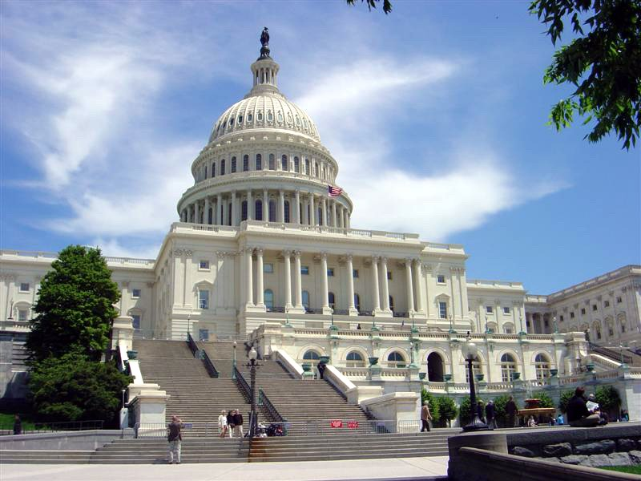
United States Congress
The Congress convenes in the US Capitol in Washington DC (535 congressmen)
House of Representatives (435 representatives) – proportional representation
Senate (100 senators) – two senators per state
all congressmen chosen in a direct election

Slide 32
United States Congress
Federal legislative body – consent of both houses required to enact bills
Powers:
financial and budgetary matters,
collecting federal tax,
national defense (declaring war),
establishing federal courts under the Supreme Court,
admission of new states to the union,
regulation of commerce between states and with other countries,
supervision of the executive (investigation, impeachment and removal of the President, federal judges and other federal officers),
appointment of members of the Cabinet and judges (on the President’s proposal)

Slide 33
United States Congress
Each house has some reserved powers:
House of Representatives: proposing bills on tax collection, power of impeachment of federal officials (both executive and judicial) for "Treason, Bribery, or other high Crimes and Misdemeanors“
Senate: ratification of treaties, confirmation of top presidential appointments, trying cases of impeachment

Slide 34
United States Congress
Impeachment
a simple majority in the House is required to impeach an official
a two-thirds majority in the Senate is required for conviction
a convicted official automatically removed from office
in addition, the Senate may stipulate that the defendant be banned from holding office in the future.

Slide 35
Thank you for your attention!

